Slide 1
Final Report of Our Summer Research
WANG Ruopeng, WANG Chaoyi, ZHU Jiaying
Oct. 17, 2020

Slide 2
PART 1 Our Goal

Slide 3
Design a narrow-band polarizer:
Transmission
1
O
Wavelength (nm)
Bandstop
Notes:
Our goal is to design a narrow-band polarizer. Its performance is like this. The transmission curve has a deep at the specific wavelength. While in other part it remains one.

Slide 4
PART 2 Previous Preparation

Slide 5
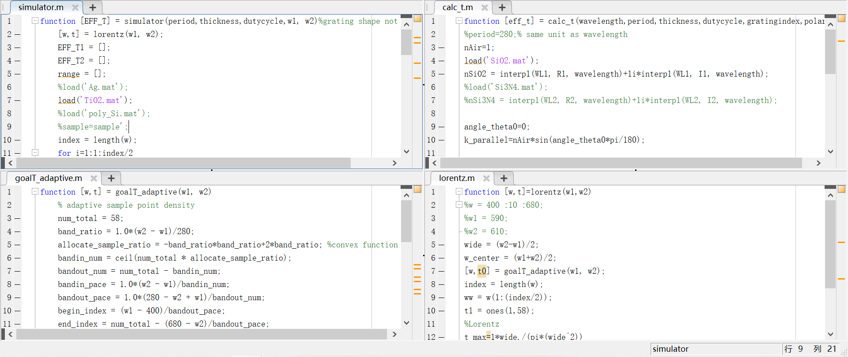
RCWA
Mainly 4 function in MATLAB to use RCWA to calculate the transmission
Top function which uses other three function, plots the figures and passes the parameters.
Define the structure and run RETICOLO kit to calculate the transmission of one wavelength
Generate the samples which is of different density
Generate the Lorentz Line-shape as the optimization goal
Notes:
We have written 4 functions in MATLAB to use RCWA to calculate the transmission.

Slide 6
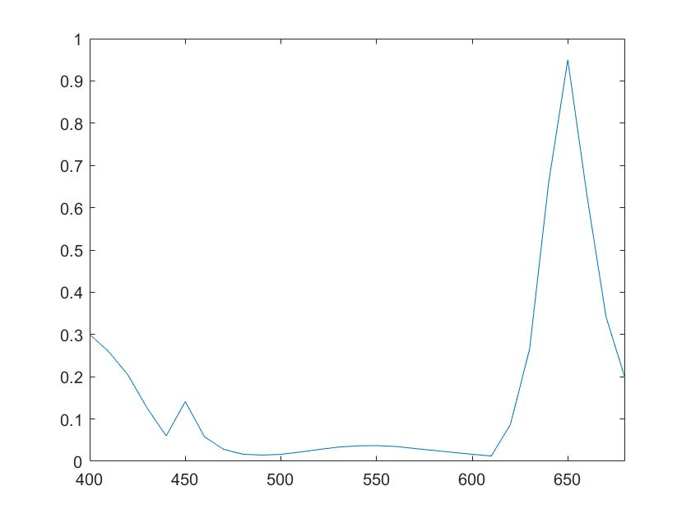
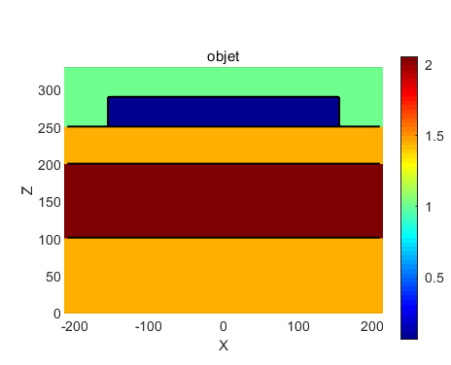
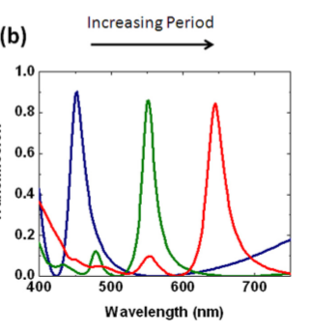
Test
Air
Ag
Si3N4
SiO2
The same as the red line
It is a structure from the reference paper to test the accuracy of the code
Notes:
This is a test to check whether RCWA runs correctly. The left figure shows the structure we use. The top layer is silver, then Silicon nitride is between 2 layers of silicon dioxide. As it shows in the right figure, the simulation result is almost the same as the result shown in the paper. Therefore, it is correct.

Slide 7
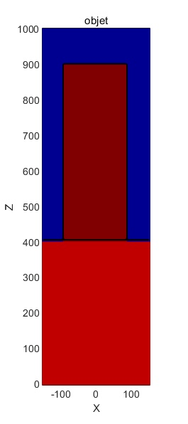
Structure for Optimization
Wavelength: 400~680nm
air
Optimization parameter:
period of grating
thickness of grating
duty-cycle of grating
TiO2
Glass substrate
Index of materials:
change with wavelength
Notes:
Here is our structure for optimization. Titanium Dioxide is on the silicon dioxide. Wavelength interval is between 400 to 680 nanometers. The target parameters to be optimized includes period of grating, thickness of grating, duty-cycle of grating.
Download the data of all wavelength ranges from the Internet, then save them in a mat format, and then do interpolation and index with the required wavelengths.

Slide 8
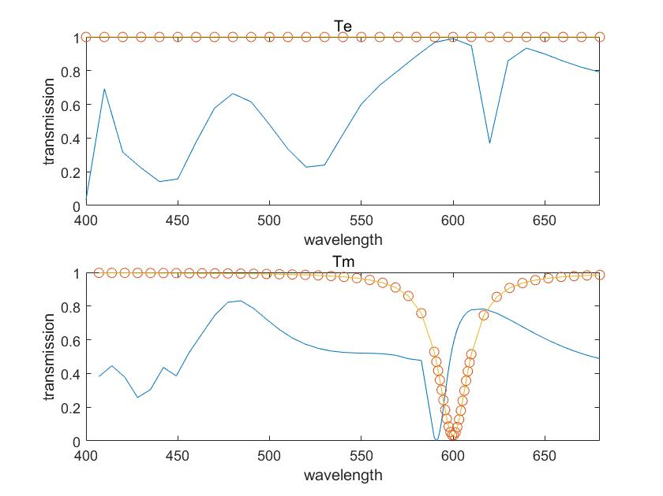

Test of the Structure
thickness
range of bandstop
period
duty-cycle
The number of samples are different in TE and TM. The density of samples changes with the range of bandstop.
This picture is obtained by randomly inputting parameters into RCWA
Notes:
The left figure shows our optimization result. Orange points are our goal and blue curves are simulation results. In the bandstop area, sampling points are denser than anywhere else. As for TM mode, the result is good, both curves coincide with each other pretty well in the bandstop area.

Slide 9
PART 3 Our Method

Slide 10
KEY: Bayesian Optimization
A method of global optimization.
Aims to solve hyperparameter problems.
Function between structure parameters and simulating transmission is a black box, which can be minimized via Bayesian optimization.
Notes:
Bayesian optimization is the most important part of our work.

Slide 11
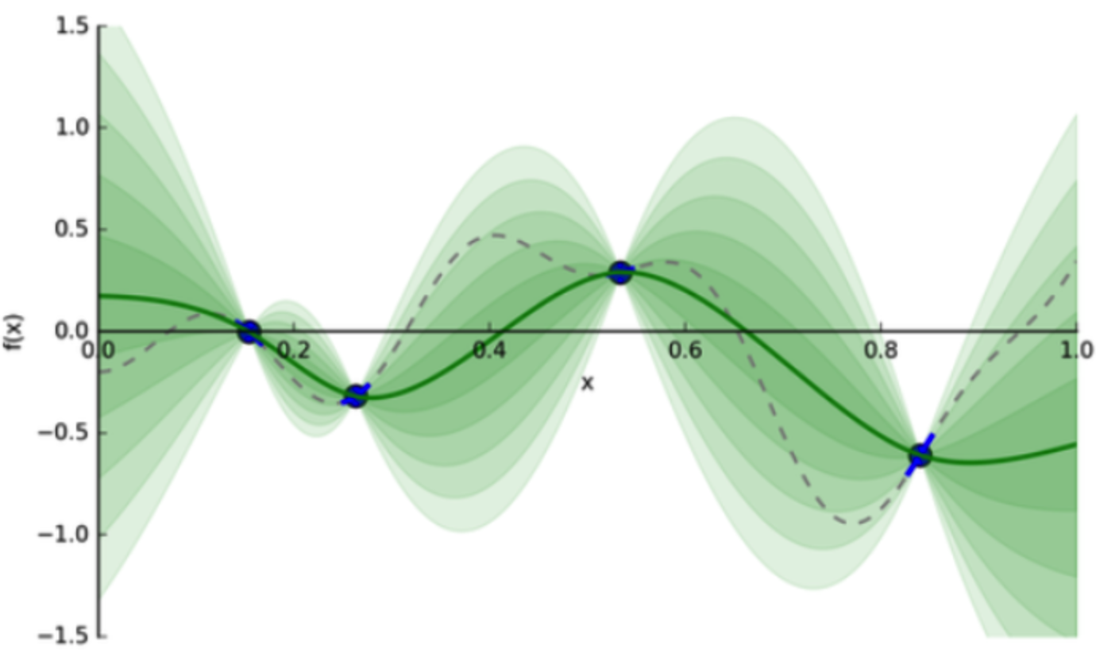
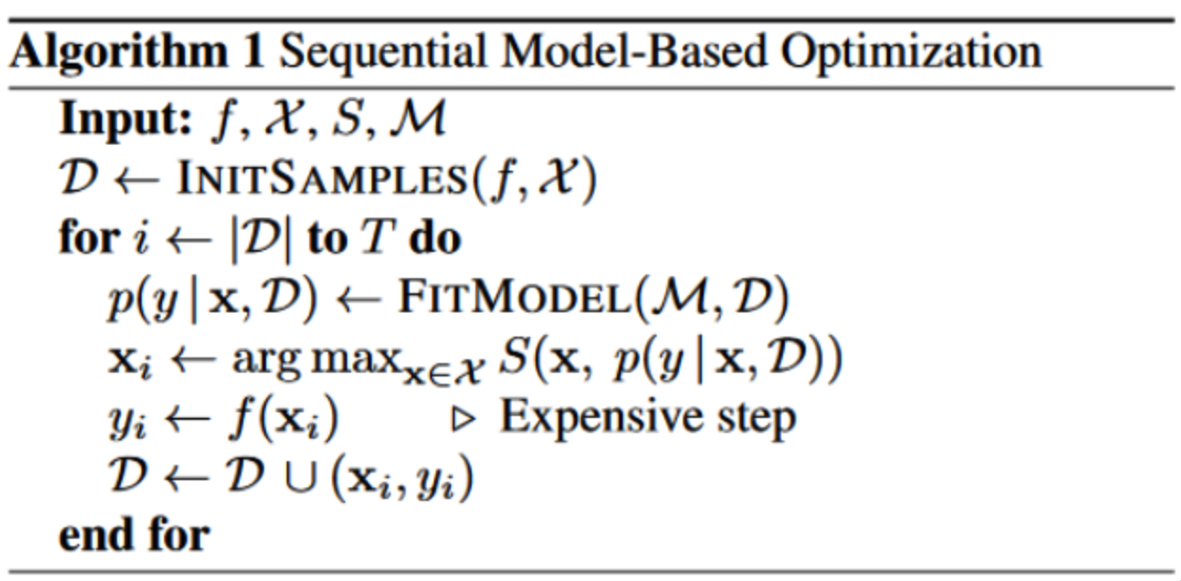
Bayesian Optimization
// Initialize D by sampling
// Loop for T times
// Choose x
// Update dataset D
Each additional band of green is another half standard deviation on the output distribution.
f: Black box, input a set of hyperparameters to get an output value.
X: Hyperparametric search space.
S: Acquisition function, which is used to select x.
M: Gaussian process model obtained by fitting dataset D.
D: A data set composed of several pairs of data, each pair of arrays is represented as (x, y), x is a set of hyperparameters, y is the result of the set of hyperparameters.
Notes:
Here is a simple explanation about BO. As for the algorithm, we input 4 variables,f,X,S,M… And we assume that the model is Gaussian. As it shows in the right figure, after several iterations, we can get a evaluation about hyperparameters which determine the black box function.

Slide 12
PART 4 Code Explanation

Slide 13
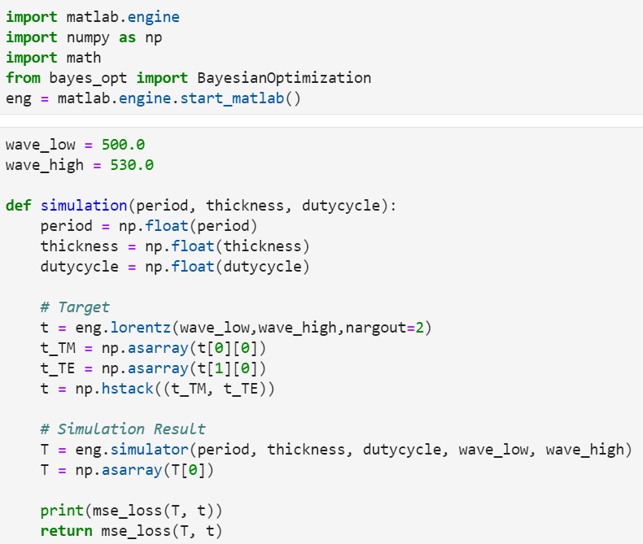
Calling MATLAB from Python
The MATLAB Engine API for Python provides a package for Python to call MATLAB as a computational engine.
Get the sample points of out target
Start simulation

Slide 14
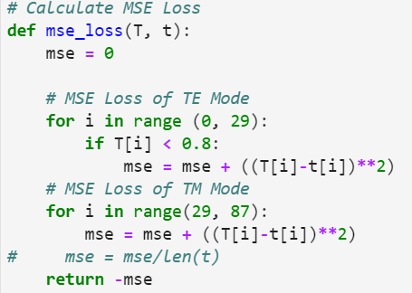
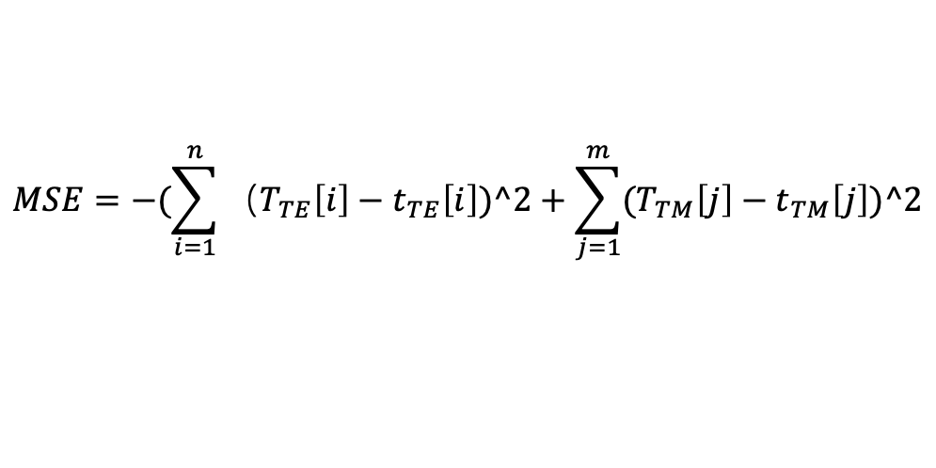
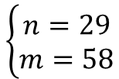
Calculate MSE Loss
$$MSE=−(\sum_{i=1}^{n}{{（T}_{TE}\left[i\right]−t_{TE}\left[i\right])^2+\sum_{j=1}^{m}{{(T}_{TM}\left[j\right]−t_{TM}\left[j\right]})^2}$$
$$\left\{\begin{aligned}n=29 \\ m=58\end{aligned}\right.$$
Notes:
We used this function to calculate MSE loss. MSE loss is defined as this formula. N represents the total sample points of TE mode. m represents the total sample points of TM mode. We reduce the weight of TE mode, so we define n = 29 and m = 58.

Slide 15
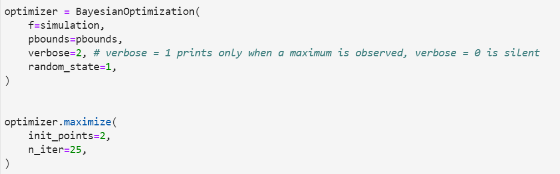
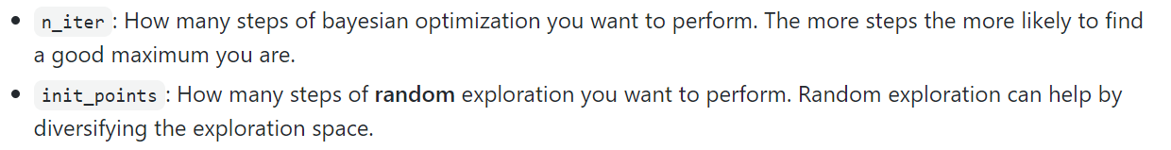
Set Searching Bounds
Do the Bayesian Optimization

Slide 16
PART 5 Optimization Result

Slide 17
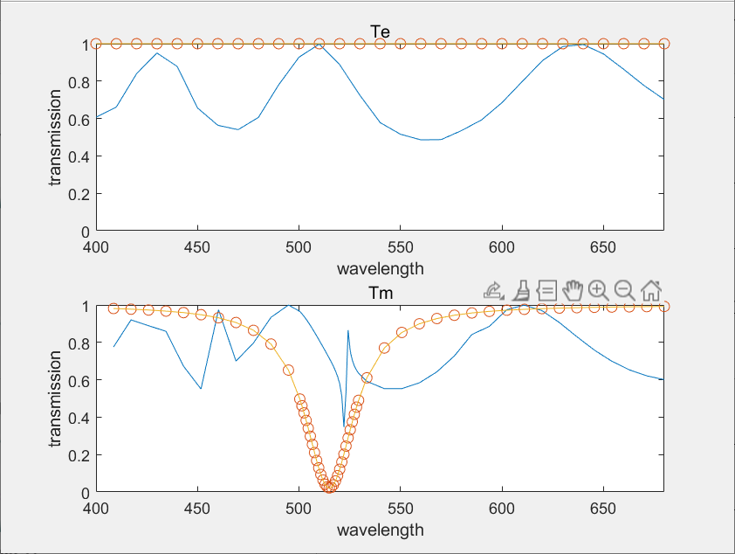
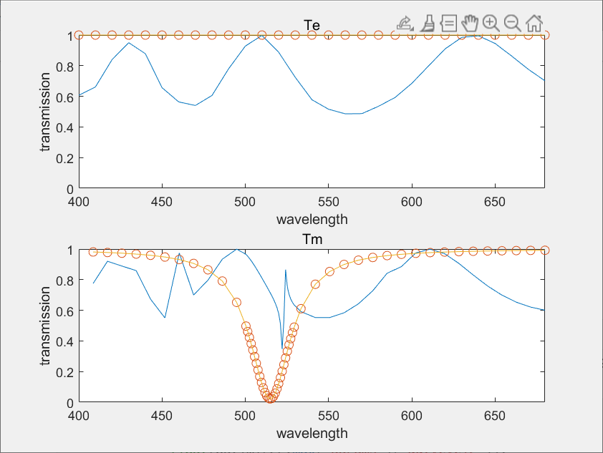
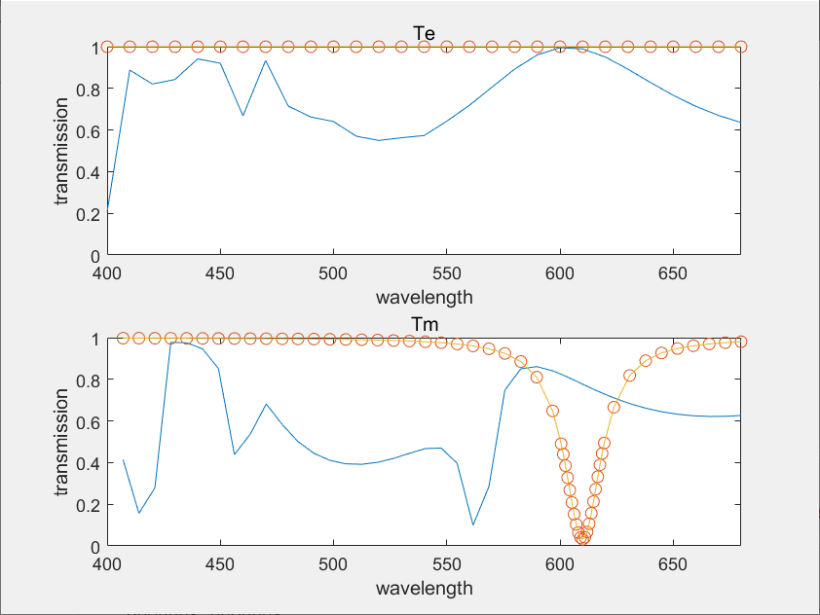

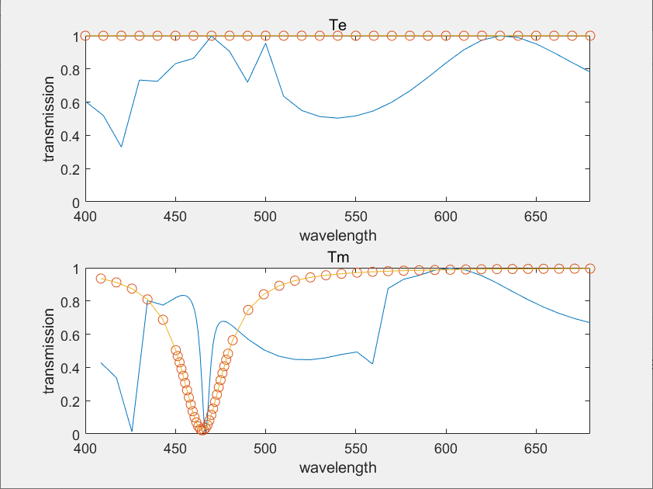

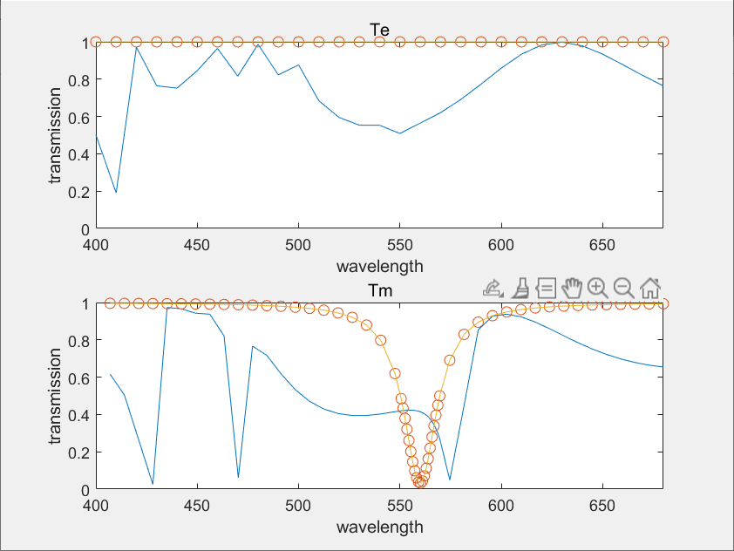
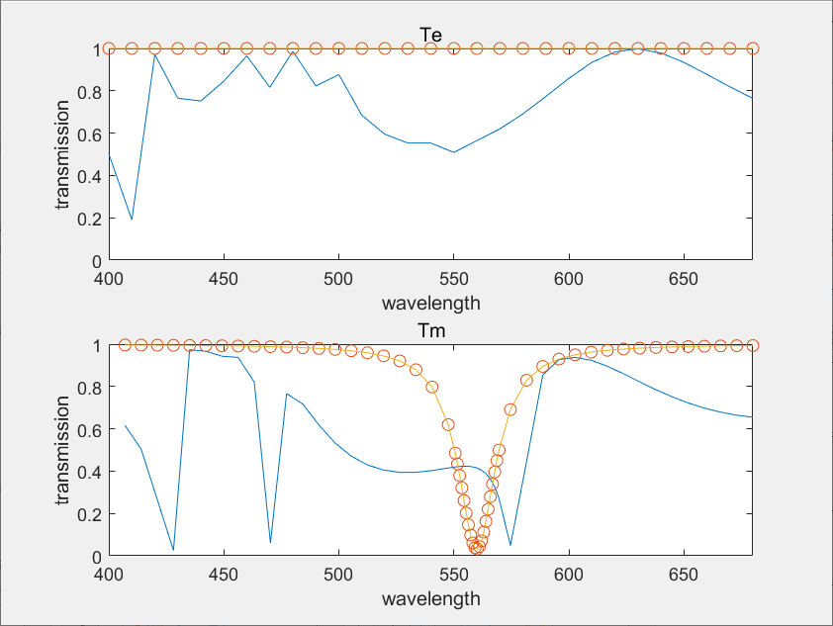
450-470
500-520
600-620
'period': (200.0, 600.0), 'thickness': (200.0, 600.0), 'dutycycle':(0.5,0.95)
Target Line with Sample Points
Simulation Result
550-570
Notes:
Here is our result. We chose 3 hyperparameters, period ranges from 200 to 600, thickness ranges from 200 to 600, dutycycle ranges from 0.5 to 0.95. The orange line is our target with sample points. The blue line is the simulation result. As you can see, some have a good performance like 450-470 and 550-570, while others do not.

Slide 18
Existing problems
Structure is not good.
Simulation curves are unstable.
Future work
Add a layer on the glass substrate.
Change materials or shapes of the grating.
Try other methods of global optimization.

Slide 19
THANK YOU

